Slide 1

Docker进阶
docker-compose
讲师：@刘智

Slide 2
docker compose

Slide 3
今日主要内容
docker compose
docker-compose
stack
dockerfile
logs
stats
c
c
c
c
c
node1
node2
8080:80
8080

Slide 4
DOCKER COMPOSE
docker compose
DOCKER COMPOSE/docker stack
它是一个编排工具
docker-compose up -d
docker stack deploy -c docker-compose.yaml NAME
完成某一功能的一组服务
yaml
s1
c 1.1
c 1.2
docker-compose
s2
c 2
dockerd
s3
c 3

Slide 5
DOCKER COMPOSE
docker compose
DOCKER COMPOSE 安装
项目地址：https://github.com/docker/compose.git
获取docker-compose
curl -L "https://github.com/docker/compose/releases/download/1.27.4/docker-compose-$(uname -s)-$(uname -m)" -o /usr/local/bin/docker-compose
chmod u+x /usr/local/bin/docker-compose

Slide 6
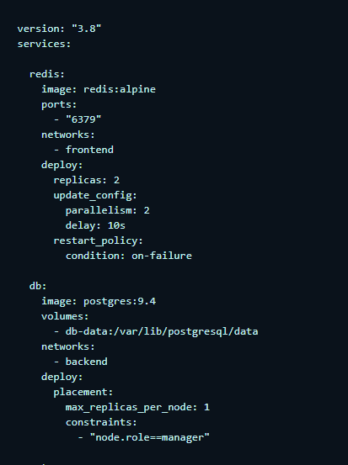
DOCKER COMPOSE
docker compose
DOCKER COMPOSE FILE REFERENCE
docker-compose.yaml用以定义启动的服务组，适用于大规模编排服务
主要定义3个内容：
services
networks
volumes
yaml

Slide 7
DOCKER COMPOSE
docker compose
docker-compose file语法详解

Slide 8
Docker进阶
感谢观看 THANK YOU
讲师：@刘智

